Slide 2
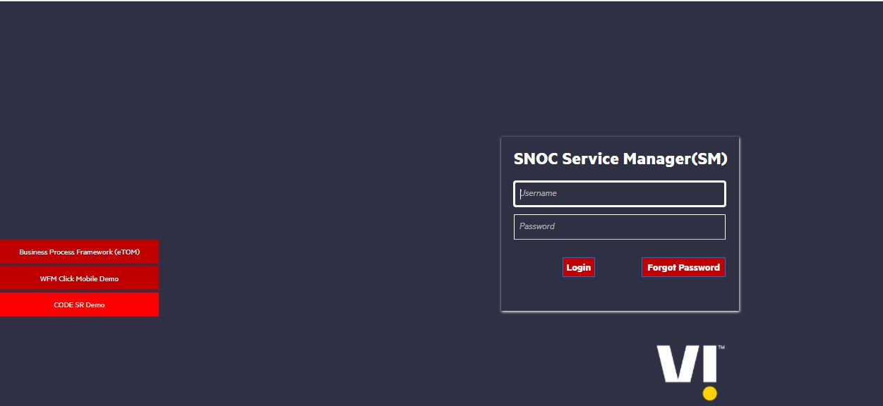
HPSM ( HP Service Manager Software )
The HP Service Manager Incident Management System manages tickets and is configured to send back events to the gateway. The Gateway for HP Service Manager uses the network record category by default.
Login URL: http://10.19.32.29:9090/SM960/index.do?lang=en

Slide 3
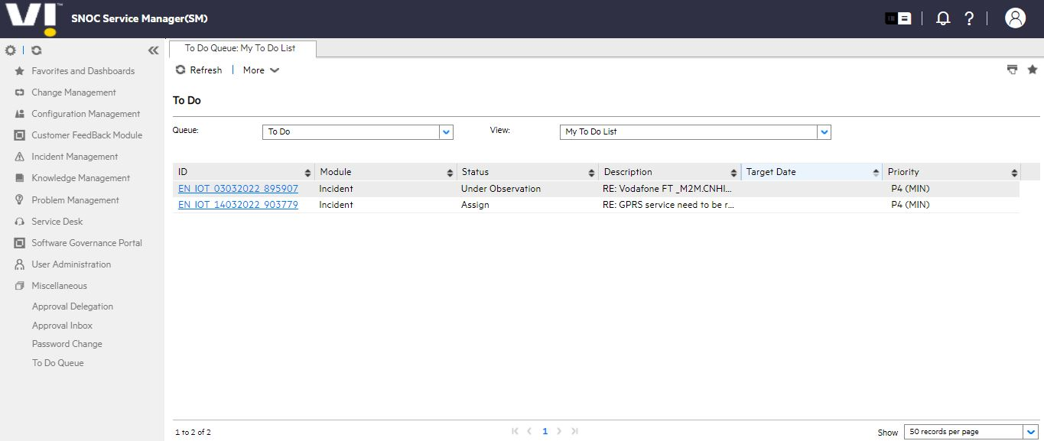
HPSM Home Page

Slide 4

CISCO Finesse
Cisco Finesse is used for making outbound call to the customer and Inbound call handle for customer query
Login URL: https://ndc3vapafin7a.inroot.in:8445/desktop/

Slide 5
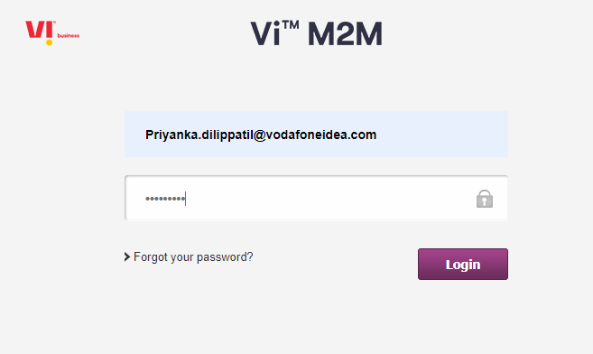
GDSP
Login URL : iotportal.myvi.in

Slide 6
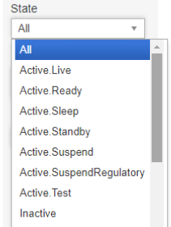
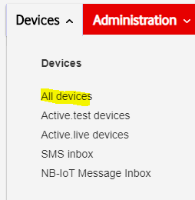
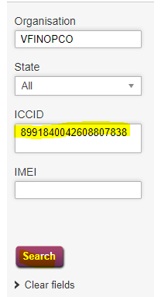

States in GDSP and Customer details
How to check customer details

Slide 7
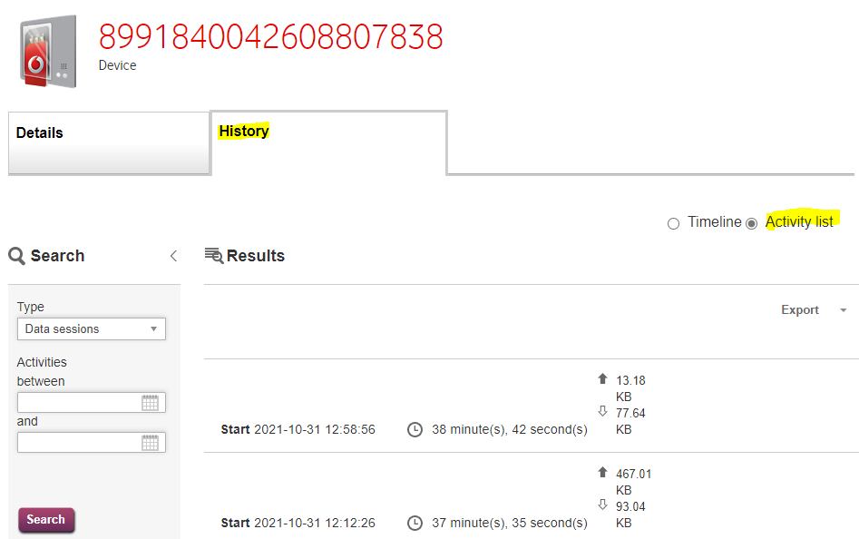
To check history of data usage

Slide 8
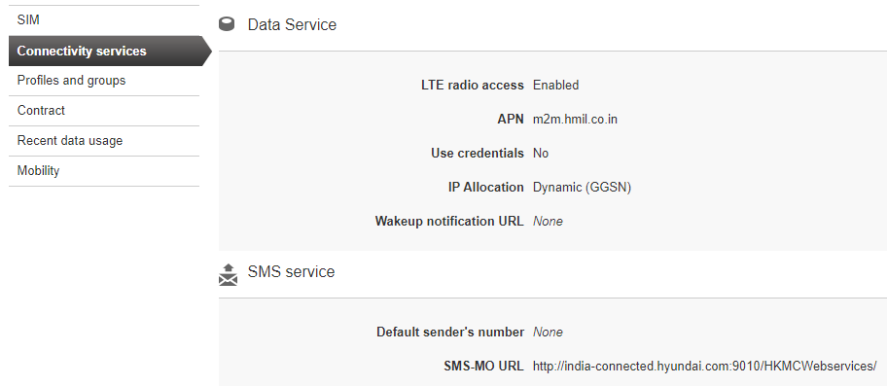
To check APN and solution type

Slide 9
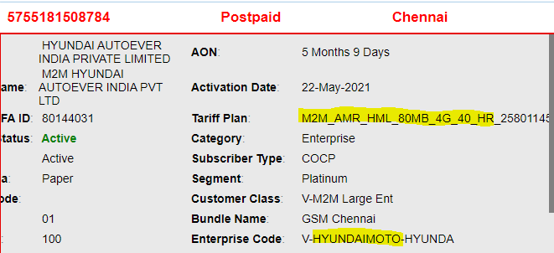
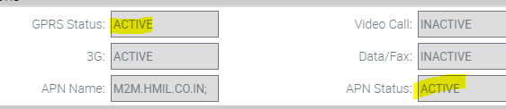
Steps to check GDSP solution.
There are two plans.
1)HR : High Rental
2)LR : Low Rental
Under High Rental(HR), sim services will be in active and it will be in below state.
Active.Live
Active.Ready
SCRM View
GDSP View

Slide 10
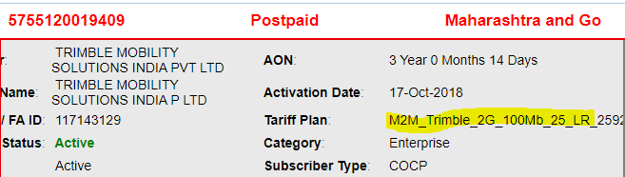
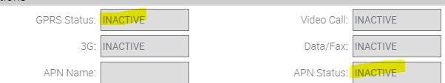

Steps to check GDSP solution.
Under Low Rental (LR), sim services will be in inactive and it will be in below state.
Active.Suspend
SCRM View
GDSP View

Slide 11
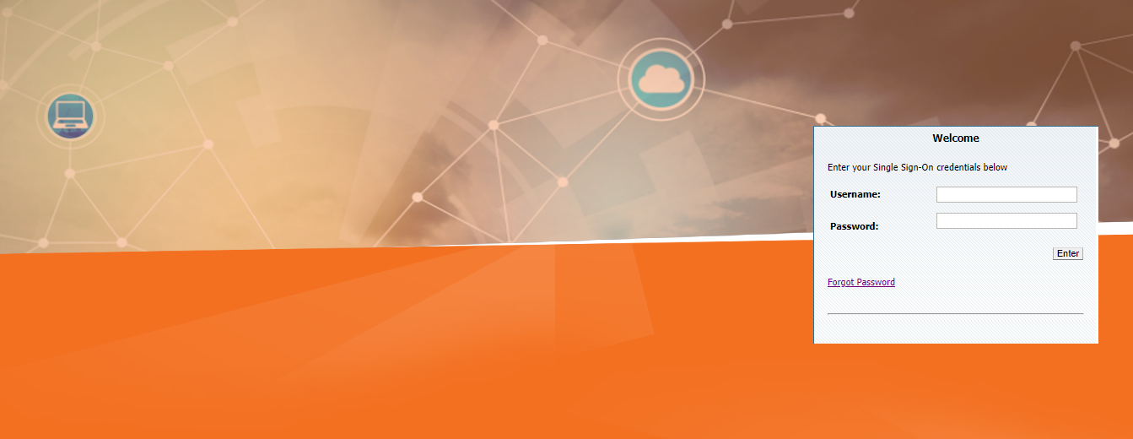
SCRM Login Page
SCRM- East : https://sumeru-east.vodafoneidea.in:6100/ecommunications_enu/start.swe?
SCRM- South : https://sumeru-south.vodafoneidea.in:6100/ecommunications_enu/start.swe?

Slide 12
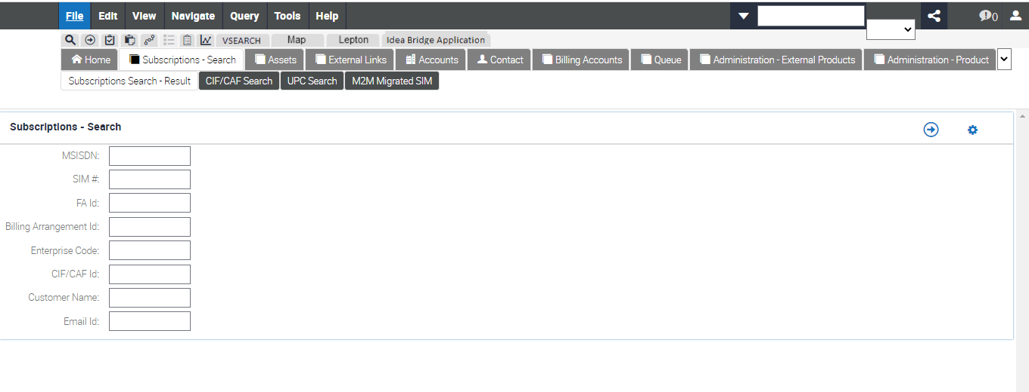
SCRM Home Page

Slide 13
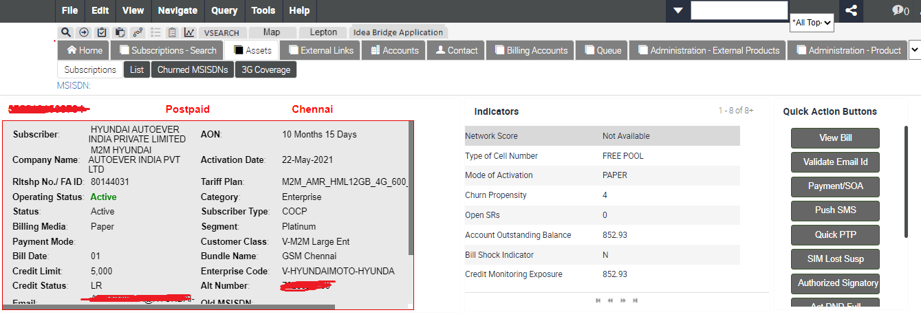
SCRM Dashboard

Slide 14
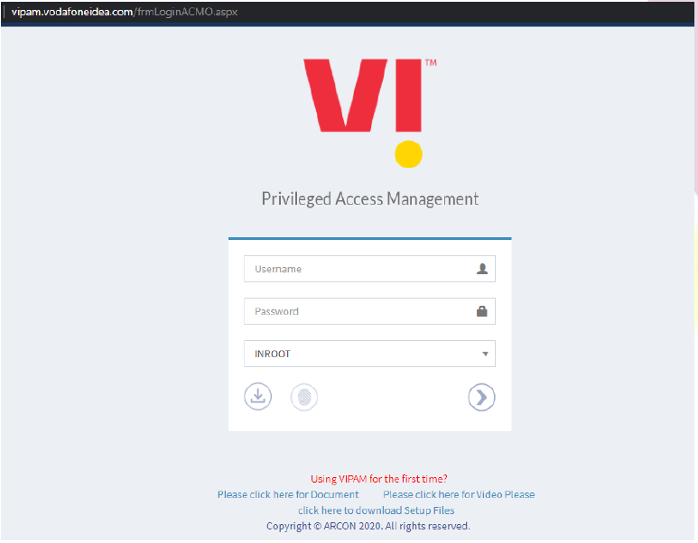
VIPAM Login Page
Login URL: https://vipam.vodafoneidea.com/frmLoginACMO.aspx
Login to application with your AD credentials.
Enter the domain ‘Username’ and ‘Password’.
Select Domain ‘INROOT’
Click on Login Button

Slide 15
VIPAM Home Page
Once you are successfully logged in you will get the below is the welcome screen:

Slide 16
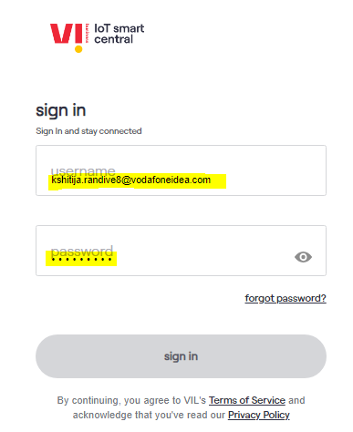
Login to your CMP portal with domain ID and Password

Slide 17
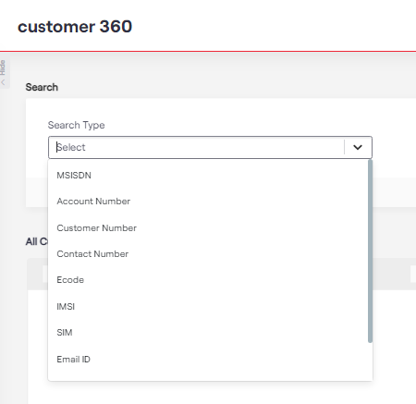
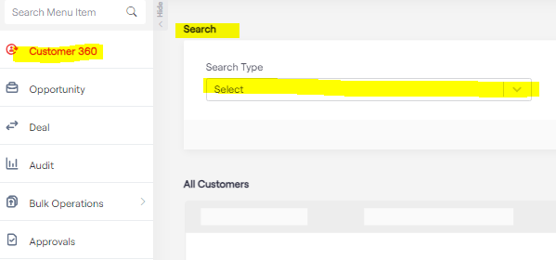
SCRM Checks
Select the search type in search box, you get below options, MSISDN, SIM number, Account Number etc.

Slide 18
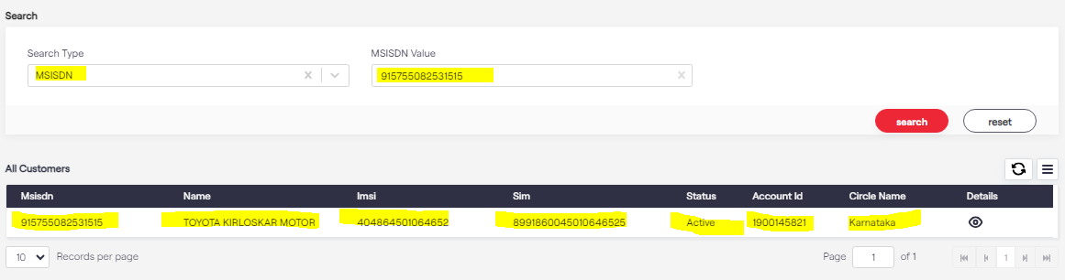
SCRM Checks
Punch the number in MSISDN value. You will fetch the details as below. Than view the details in details tab

Slide 19
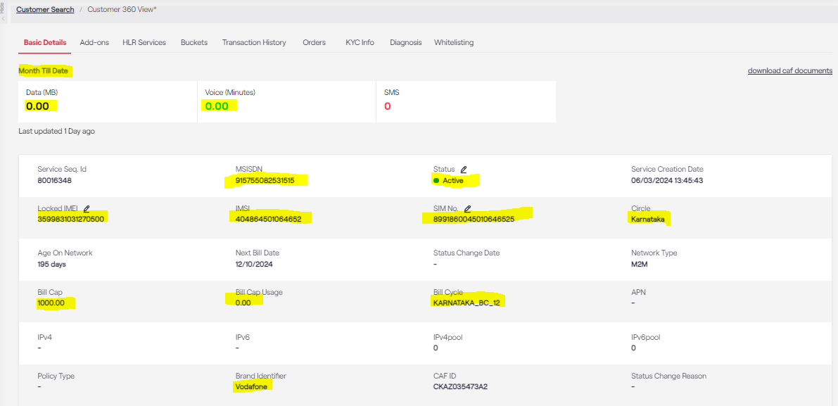
SCRM Checks
Punch the number in MSISDN value. You will fetch the details as below. Highlighted fields are mandatory.

Slide 20
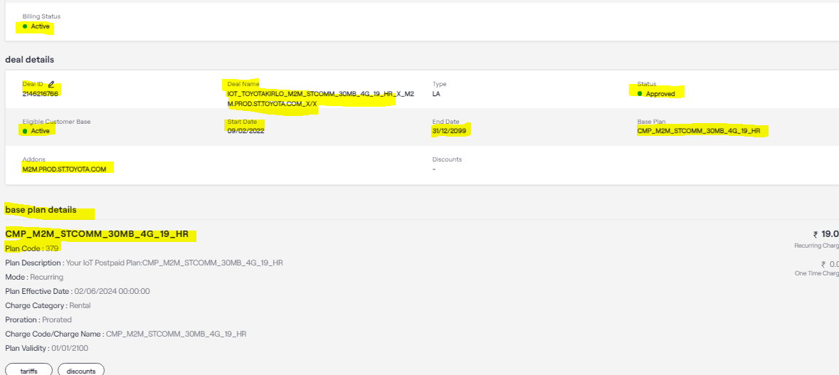
Pre-checks
Check the status of the affected number, Deal Name, APN is correct or not

Slide 21
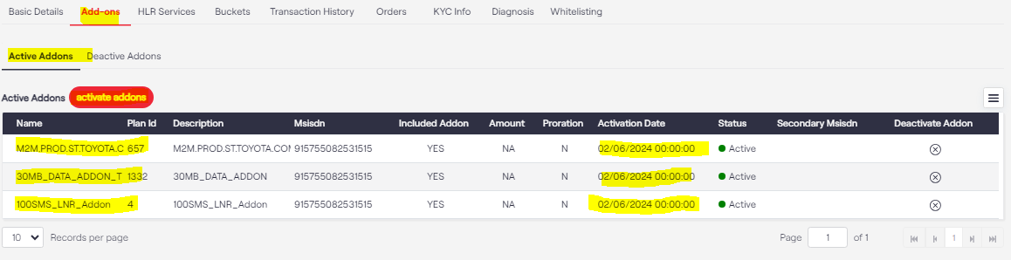
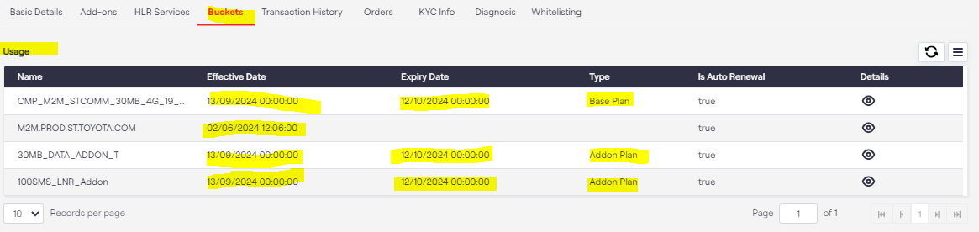
Pre-checks
Check the Add-ons parts. You will able to see which services and plan are active
With Add-ons we need to check Buckets- details- what is active date and expiry date.

Slide 22
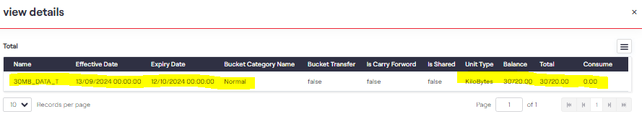
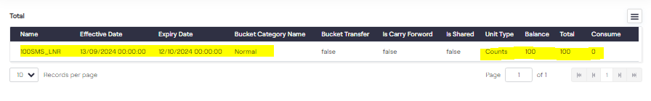
Pre-checks
In buckets we need to check add-on services balance for Data as well as SMS

Slide 23
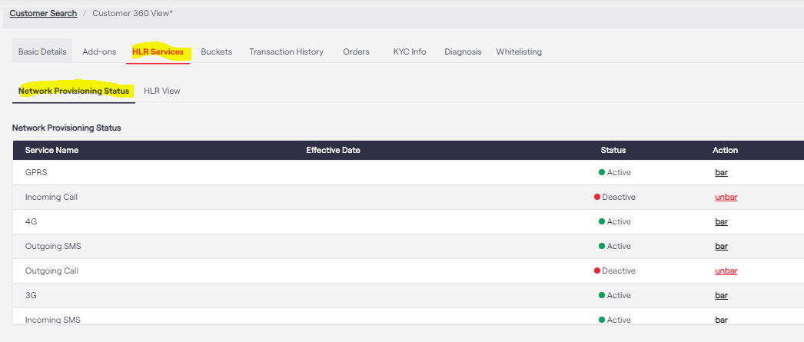
Pre-checks
Pre-checks should be done for all the services in the HLR view and Network Provisioning Status tab.

Slide 24
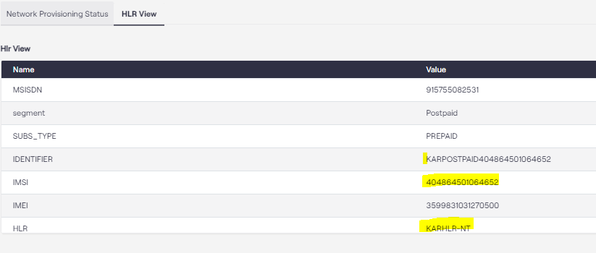
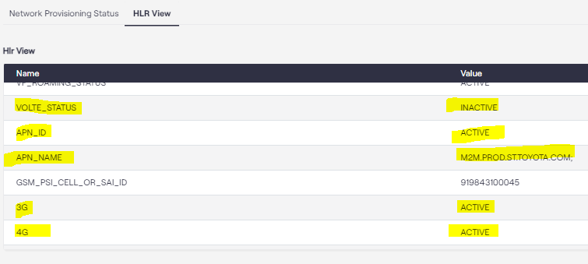
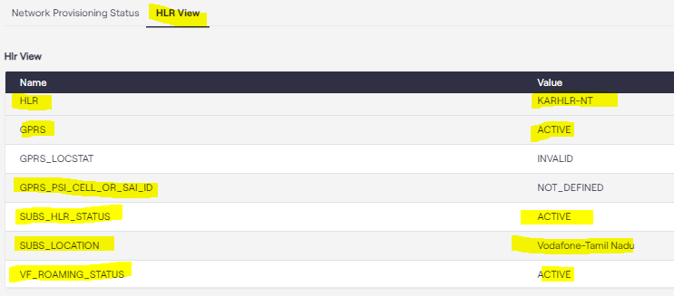
Pre-checks
APN Status- Active
APN ID- Active
GPRS- Active
2G- Active
4G- Active
VOLTE Status- Active
HLR- Active
Roaming- Active
Barring- Inactive

Slide 25
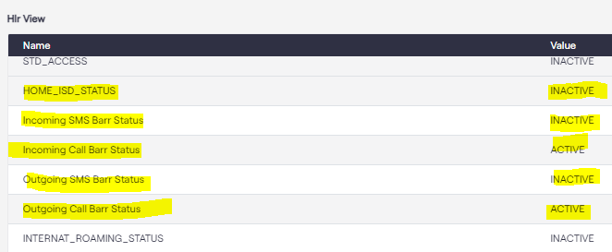
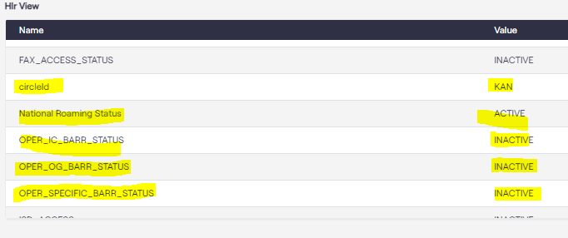
Pre-checks

Slide 26
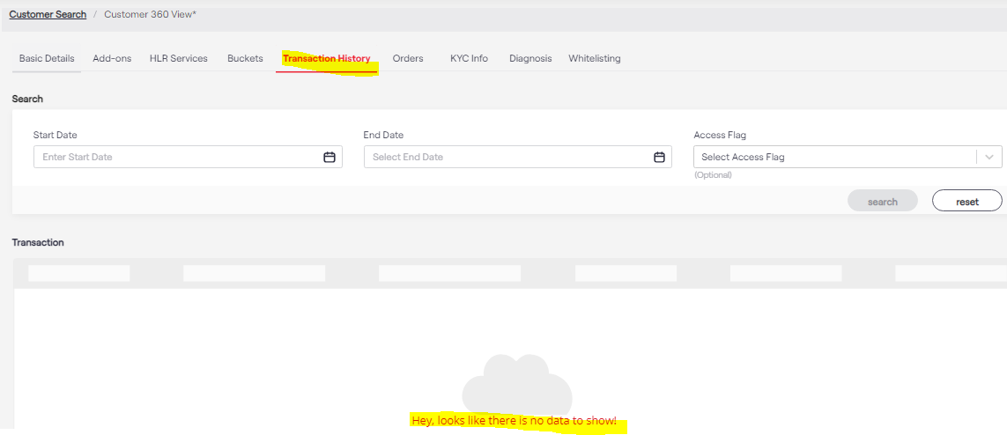
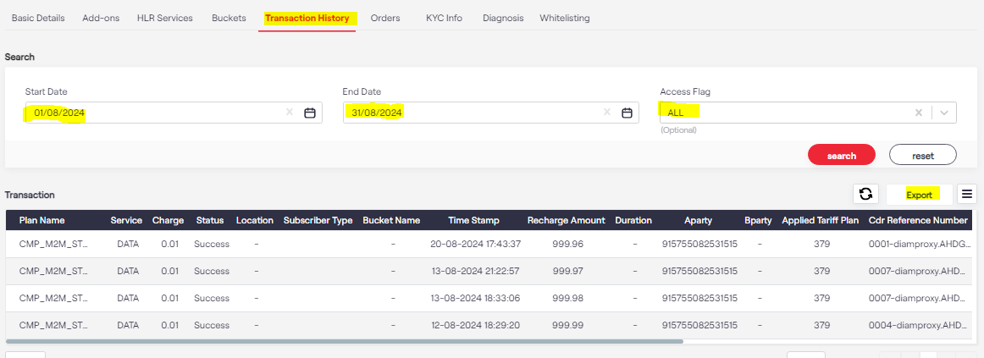
Pre-checks
The latest data transaction history should be checked.
You can select a particular data range also.
Only 90 days of data is stored.

Slide 27
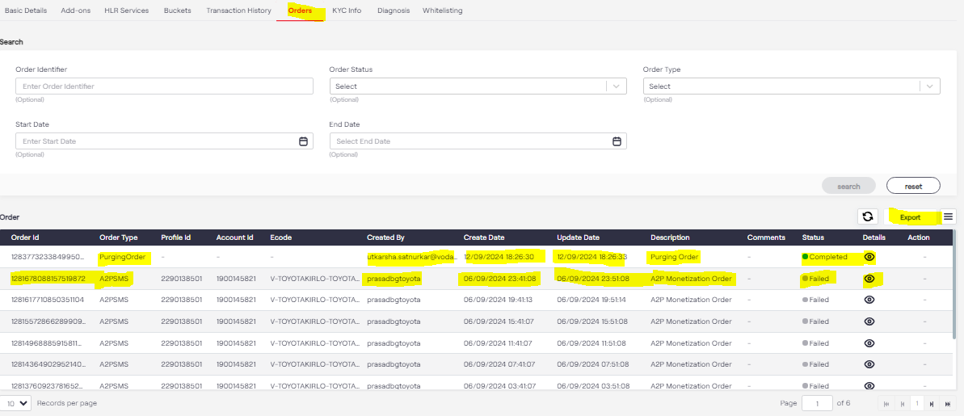
Pre-checks
Check and recent plan changes, deal changes, status changes done on any affected number.

Slide 28
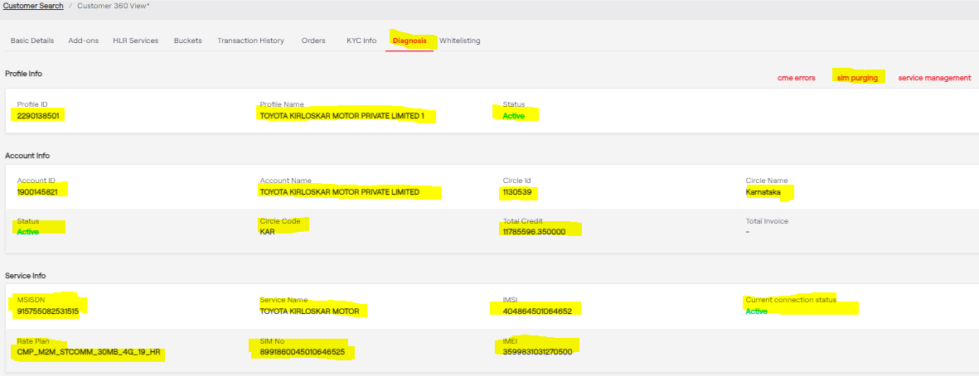
Pre-checks
On the Diagnosis page we can do the SIM purging and also can cross- check the rest of the details that are highlighted

Slide 29
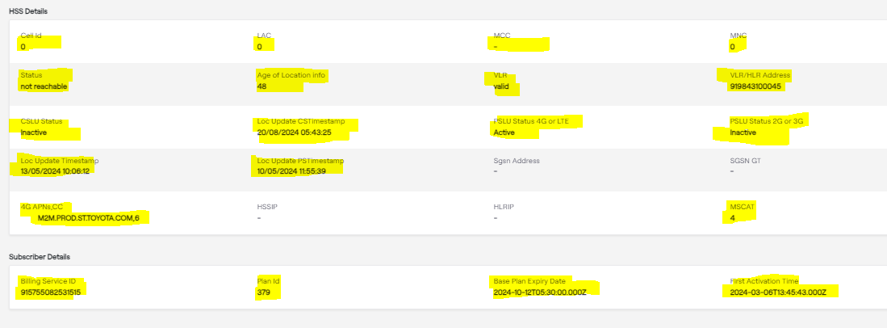
Pre-checks
HSS details will show the HLR deatils

Slide 30
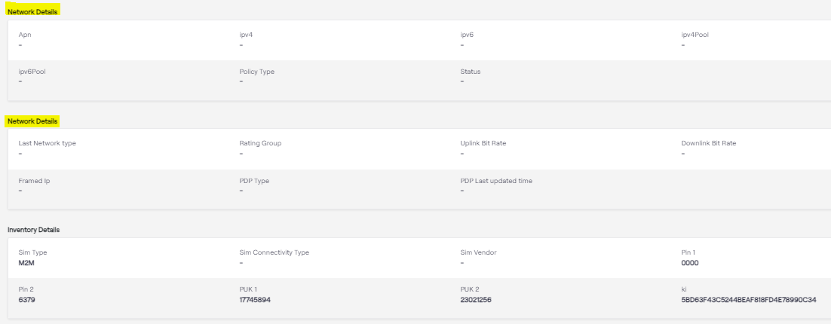
Pre-checks
Used to check AAA configuration
Used to check any normal/ Dynamic HLR configuration

Slide 31
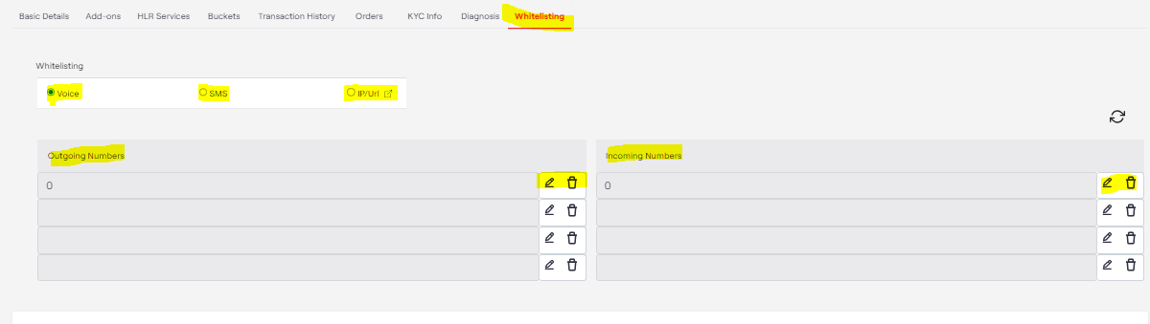
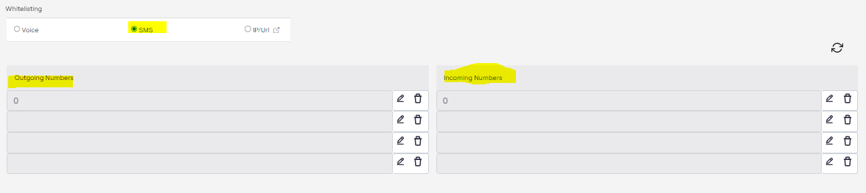
Whitelisting Pre-checks
Whitelisting for SMS services
Whitelisting for Voice services

Slide 32
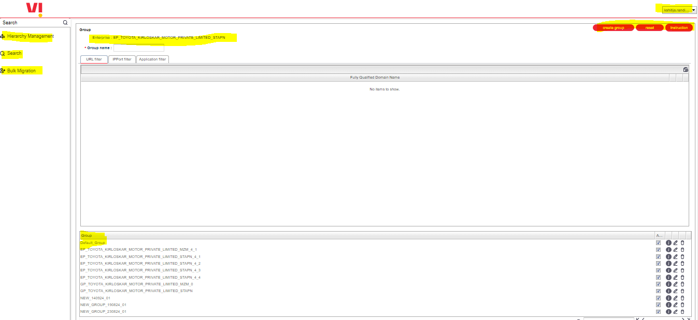
Whitelisting Pre-checks
Whitelisting for Data services on ISAFE portal

Slide 33
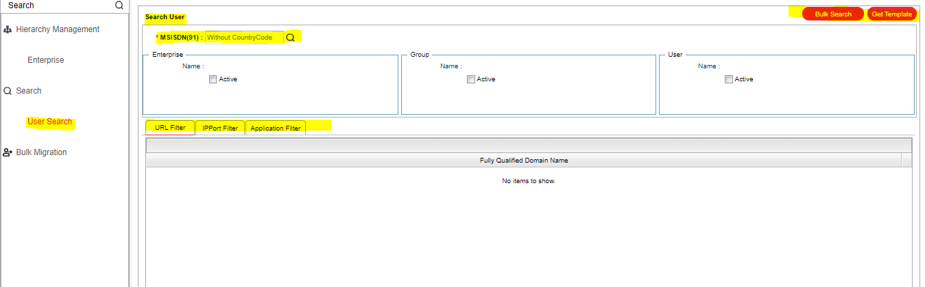
Whitelisting Pre-checks
In Search user you can check single numbers whitelisting

Slide 34
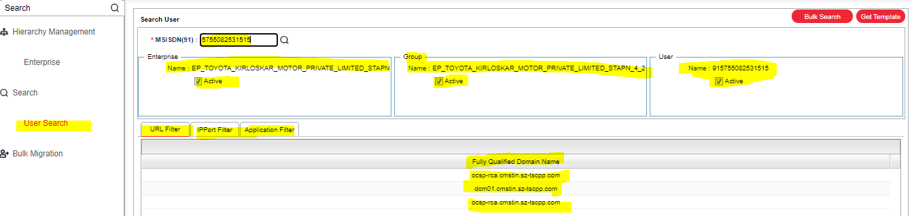
Whitelisting Pre-checks
For single number whitelisting will visible as below

Slide 35
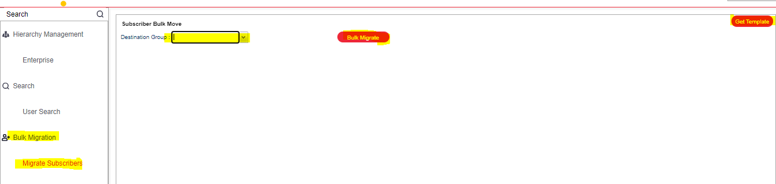
Whitelisting Pre-checks
For bulk search, you can use the Bulk Migrate option, but for whitelisting on bulk numbers you can update the file for the same

Slide 36
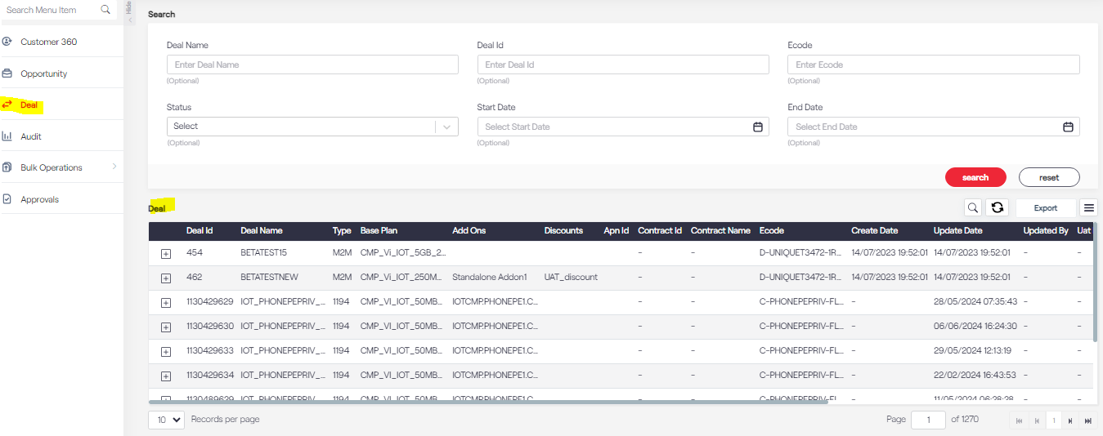
Whitelisting Pre-checks
In the Deal option, you will able to see the available deals for the particular customer which are activated at the backend

Slide 37
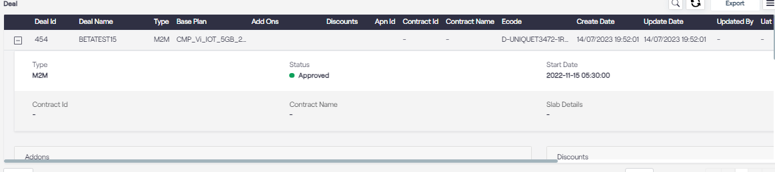
Deal Pre-checks

Slide 38
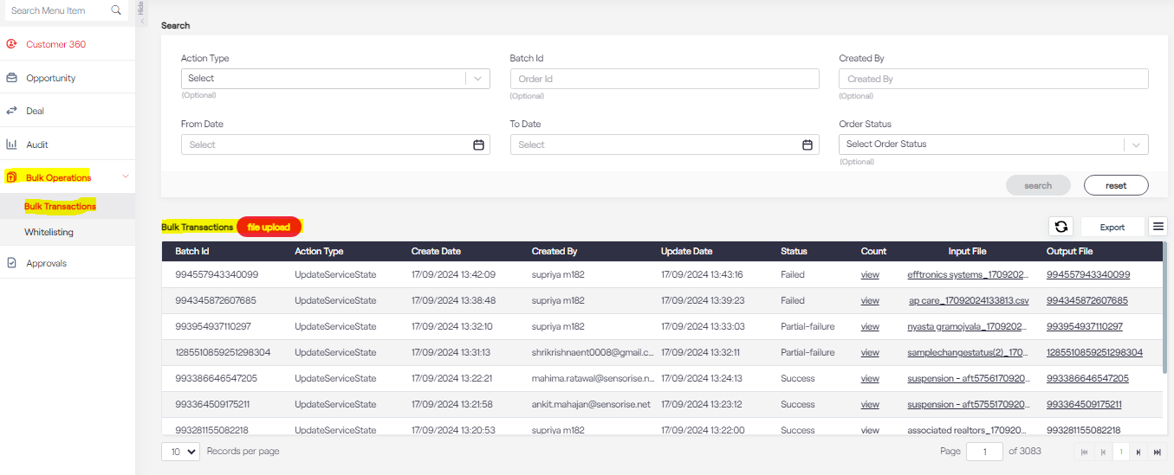
Bulk Operations

Slide 39
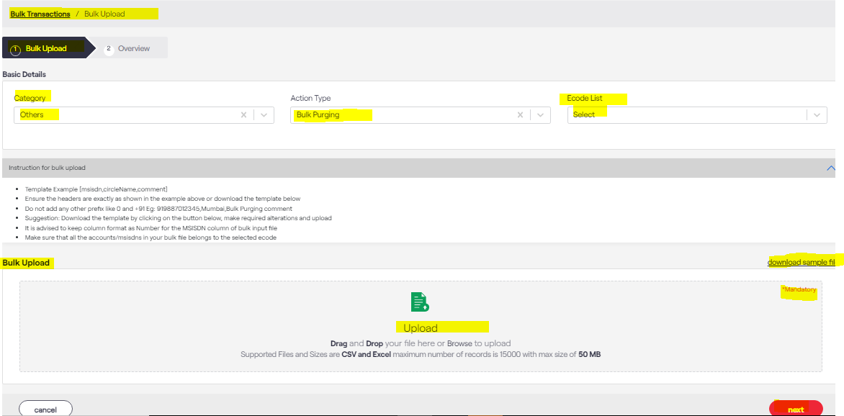
Bulk Operations
In Bulk Transaction, the customer can change the deal, change the status of the number, do the whitelisting for SMS and voice also can do the bulk purging

Slide 40
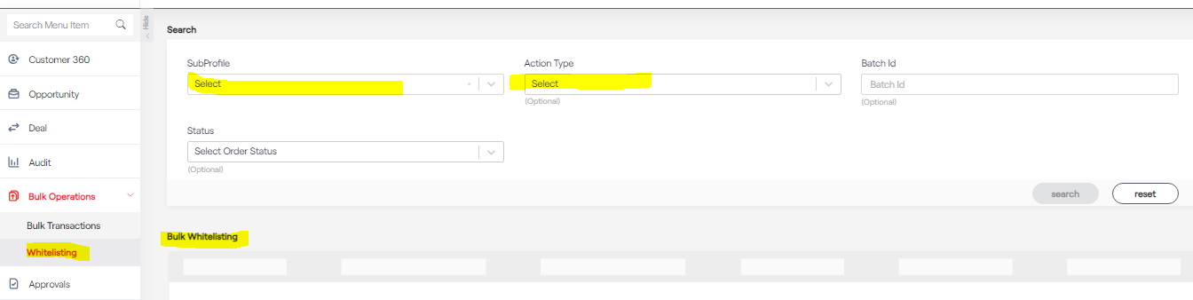
Whitelisting Operation
SMS and voice whitelisting can be done from Whitelisting option

Slide 41
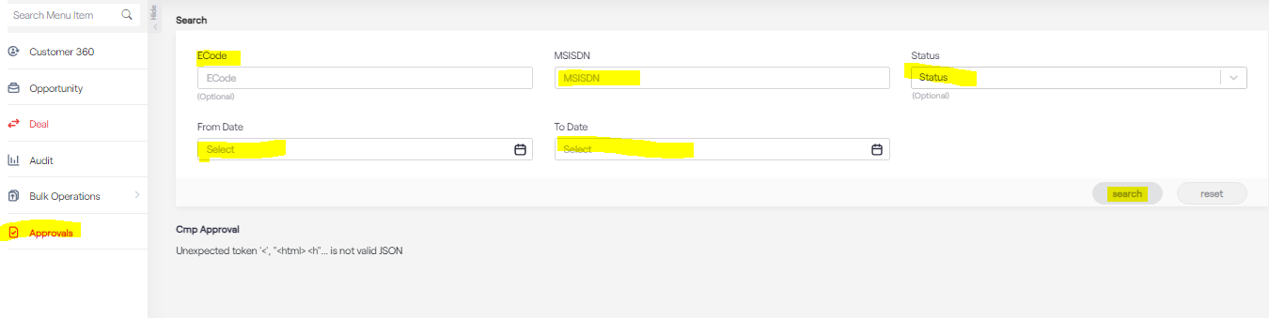
Approval Pre-checks
If the customer wants to suspend the number- those orders are pending in the approval option.

